Slide 1
Attendance via face recognition

Slide 2
AGENDA
To develop a machine learning algorithm that can detect the faces of students in a classroom photo and mark the attendance.

Slide 3
Tech stack
Mtcnn
face
recognition
numpy
Opencv(cv2)
Gradio
matplotlib

Slide 4





How its works
Load known faces
Generates encodings of them
Detecting face in the input image
Face encoding and match
Displaying results

Slide 5
DATA- STRUCTURES USED
LISTS
DICTIONARIES
NUMPY
CSV FILES
Stores :
Known images face
Present_students
Known_faces encodings
Used to associate class name(roll_no) with their respective known face encodings
Used to process and manipulate face encodings
Stores the encoding and attendance

Slide 6
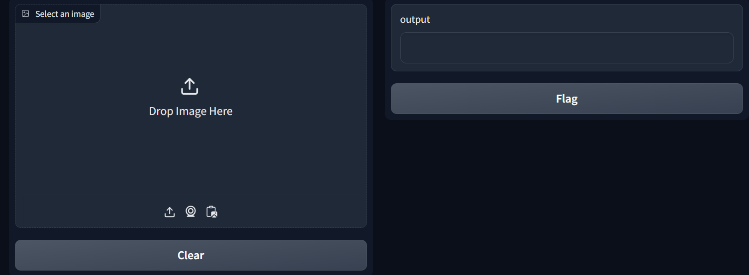
interface
The interface asking to upload a photo

Slide 7
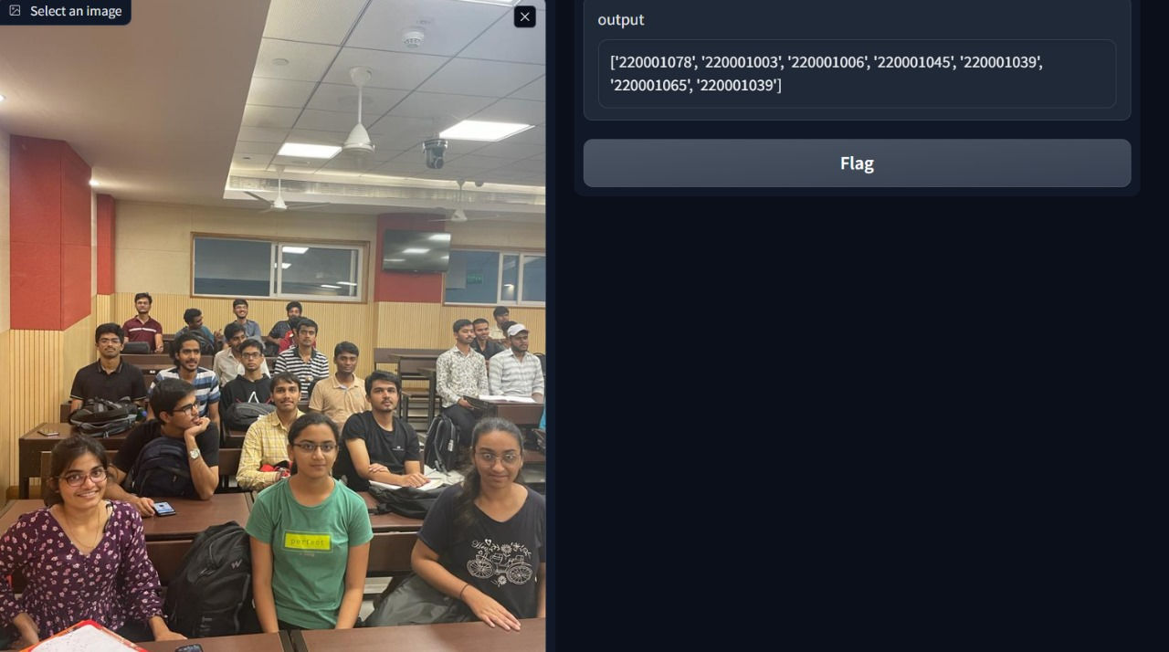
The output displays the roll number of the student detected in the photo.

Slide 8
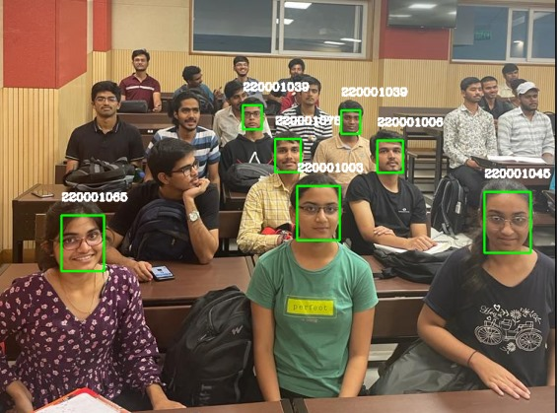
The detected and recognized faces in the uploaded image

Slide 9
Accuracy
Face Detection : 60%
Face-Recognition : 80%

Slide 10
THANK YOU
Muskan
Nikita Tayade
Kanak Nagar

